Slide 1
1st Workshop on Interactive Natural Language Technology for
Explainable Artificial Intelligence
October 29, 2019
A Survey of Explainable AI Terminology
Miruna-Adriana Clinciu and Helen F. Hastie
Edinburgh Centre for Robotics
Heriot-Watt University, Edinburgh, UK
Notes:
Introduction

Slide 2
FEAR OF THE UNKNOWN …
Notes:
The oldest and strongest emotion of the mankind is fear
And the oldest and strongest kind of fear is the fear of the unknown
It is very normal to be worried about a system that is able to make decisions on our behalf.
We all make decisions every day …
Some years ago, I decided to choose the path of XAI after the non-expert users didn’t really trust my BLACK-Box model, excepting my whole hard working and good scores for ml evalkuation metrics

Slide 3
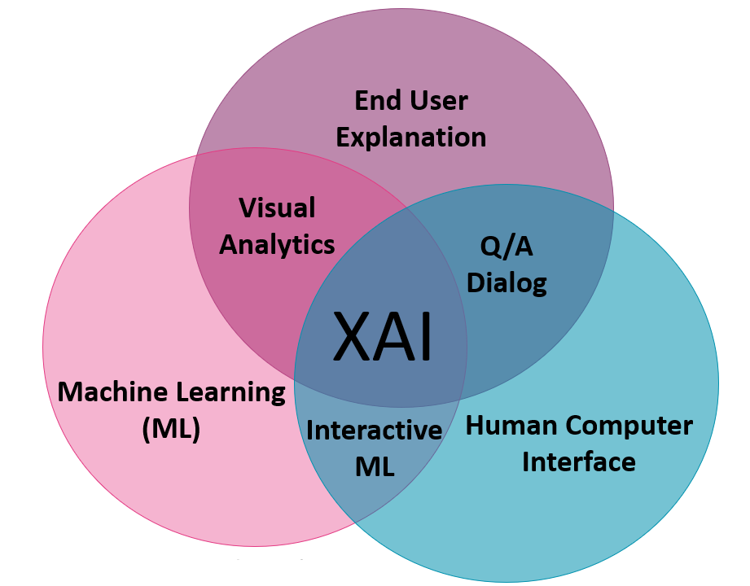
EXPLAINABLE AI…
“Explainable AI can present the user with an easily understood chain of reasoning from the user’s order, through the AI’s knowledge and inference, to the resulting behavior" [van Lent et al., 2004].
©
"XAI is a research field that aims to make AI systems results more understandable to humans" [Adadi and Berrada, 2018].
Michael van Lent, William Fisher, and Michael Mancuso. 2004. An explainable artificial intelligence system for small-unit tactical behavior. In Proceedings of the 16th conference on Innovative applications of artifical intelligence (IAAI'04), Randall Hill (Ed.). AAAI Press 900-907.
Amina Adadi and Mohammed Berrada. 2018. Peeking Inside the Black-Box: A Survey on Explainable Artificial Intelligence (XAI).IEEE Access, 6:52138–52160.
Notes:
The field of XAI ATTEMPS to solve the problem of algorithmic opacity

Slide 4
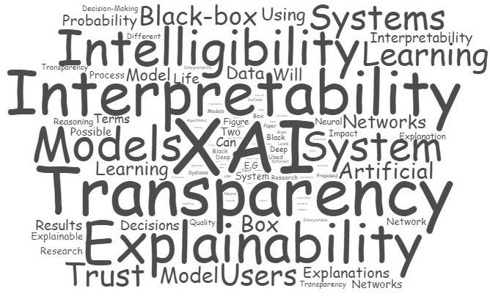
Notes:
Many terms and notions have been introduced recently to deﬁne Explainable AI,
however, these terms seem to be used interchangeably, which is leading to confusion in this rapidly expanding ﬁeld.

Slide 5
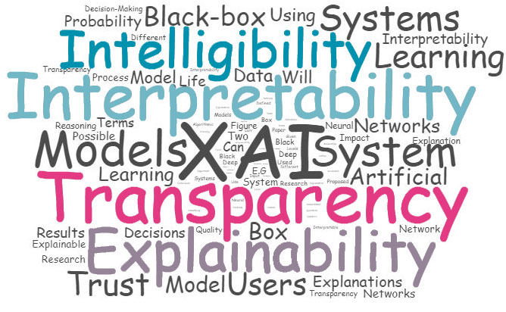
Notes:
As a solution to overcome this problem, after an analysis of the existent research literature, we examine how key terms are reffered and in what context.

Slide 6
Transparency
Intelligibility
Explainability
Interpretability
Notes:
We organised these terms in a Venn diagram that describes how a transparent AI SYSTEM has several FACETS WHICH INCLUDE
INTERPRETABILITY EXPLAINABILITY….

Slide 7
TRANSPARENCY
Dictionary definitions:
“clear and easy to understand” (Cambridge Dictionary)
“easily seen through, recognized, understood, detected;
manifest, evident, obvious, clear” (Oxford English Dictionary)
“language or information that is transparent is clear and easy to understand” (The Longman Dictionary of Contemporary English)
Notes:
For each of these terms, we present the dictionary definitions.

Slide 8
TRANSPARENCY
2008
2007
In the research paper by Cramer et al. (2008), transparency aims to increase understanding and entails offering the user insight as to how a system works, for example, by offering explanations for system choices and behaviour.
Tintarev and Masthoff (2007) state that transparency “explains how the system works” and it is considered one of the possible explanation facilities that could influence good recommendations in recommender systems.
2018
Tomsett et al. (2018) defined transparency as a “level to which a system provides information about its internal workings or structure ” and both “explainability and transparency are important for improving creator-interpretability”.
2012
“Transparency clearly describing the model structure, equations, parameter values, and assumptions to enable interested parties to understand the model” (Briggs et al., 2012)
“Informally, transparency is the opposite of opacity or blackbox-ness. It connotes some sense of understanding the mechanism by which the model works. We consider transparency at the level of the model (simulatability), at the level of individual components (e.g.parameters) (decomposability), and at the level of the training algorithm (algorithmic transparency)” (Lipton,2016).
2016
Notes:
Also, we presented quotes from literature that helped us to connect ideas and build up coherent relationships within the text.
transparency “explains how the system works”
Transparency clearly describing the model structure, equations, parameter values, and assumptions
We consider transparency at the level of the model (simulatability), at the level of individual components (e.g.parameters) (decomposability), and at the level of the training algorithm (algorithmic transparency)”

Slide 9
INTELLIGIBILITY
Dictionary definitions:
“clear enough to be understood” (Cambridge Dictionary)
“capable of being understood; comprehensible” (Oxford English Dictionary)
“easily understood” (The Longman Dictionary of Contemporary English)

Slide 10
INTELLIGIBILITY
2001
2018
“Intelligibility; context-aware systems that seek to act upon what they infer about the context must be able to represent to their users what they know, how they know it, and what they are doing about it” (Bellotti and Edwards, 2001).
It remains remarkably hard to specify what makes a system intelligible; The key challenge for designing intelligible AI is communicating a complex computational process to a human. Speciﬁcally, we say that a model is intelligible to the degree that a human user can predict how a change to a feature” (Weld and Bansal, 2018).
2009
“Intelligibility can help expose the inner workings and inputs of context-aware applications that tend to be opaque to users due to their implicit sensing and actions” (Lim and Dey, 2009).
Notes:
;context-aware systems must be able to represent to their users what they know, how they know it, and what they are doing about it” (Bellotti and Edwards, 2001).
Intelligibility can help expose the inner workings and inputs of context-aware applications
remarkably hard to specify what makes a system intelligible

Slide 11
INTERPRETABILITY
Dictionary definitions:
“to decide what the intended meaning of something is” (Cambridge Dictionary)
“clear or explicit; to elucidate; to explain” (Oxford English Dictionary)
“to explain the meaning of something ” (The Longman Dictionary of Contemporary English)

Slide 12
INTERPRETABILITY
In model-agnostic interpretability, the model is treated as a black-box .
Interpretable models may also be more desirable when interpretability is much more important than accuracy, or when interpretable models trained on a small number of carefully engineered features are as accurate as black-box models” (Ribeiro et al. 2016)
2016
2019
“We deﬁne interpretable machine learning as the use of machine-learning models for the extraction of relevant knowledge about domain relationships contained in data...” (Murdoch et al., 2019).
2018
“An explanation can be evaluated in two ways: according to its interpretability, and according to its completeness” (Gilpin et al., 2018).
Notes:
In model-agnostic interpretability, the model is treated as a black-box
.
interpretability is much more important than accuracy
An explanation can be evaluated in two ways: according to its interpretability, and according to its completeness
extraction of relevant knowledge about domain relationships contained in data..

Slide 13
EXPLAINABILITY
Dictionary definitions:
“to make something clear or easy to understand by describing or giving information about it” (Cambridge Dictionary)
“to provide an explanation for something. to make plain or intelligible” (Oxford English Dictionary)
“to tell someone about something in a way that is clear or easy to understand.
to give a reason for something or to be a reason for something”
(The Longman Dictionary of Contemporary English)

Slide 14
EXPLAINABILITY
2017
“Explanation is considered closely related to the concept of interpretability; Systems are interpretable if their operations can be understood by a human, either through introspection or through a produced explanation” (Biran and Cotton, 2017).
2019
“Transparent design: model is inherently interpretable (globally or locally)” (Lucic et al., 2019).
2018
In the paper (Poursabzi-Sangdeh et al., 2018), interpretability is deﬁned as something “that cannot be manipulated or measured, and could be deﬁned by people, not algorithms”.
2018
“I equate interpretability with explainability” (Miller, 2018).
Notes:
It is very clear that, Interpretability is defined as a concept close to explainability also mentioned in other papers.
Transparent systems could be, by their nature interpretable, without providing explanations.

Slide 15
How can we learn from nlg ?
Natural Language Generation will be key to providing explanations, and rationalization.
XAI can learn how to structure and generate explanations from NLG (both rule-based and data-driven approaches).
A framework for evaluation of explanations is necessary, providing subjective and objective measures for transparency, interpretability etc., but also combined with traditional NLG metrics.
Notes:
The human-like capability of NLG has the potential to increase the intelligibility of an AI system
Language is an intuitive medium.
Natural Language Generation will be key to providing explanations, and rationalization.
XAI can learn how to structure and generate explanations from NLG (both rule-based and data-driven approaches).
A framework for evaluation of explanations is necessary, providing subjective and objective measures for transparency, interpretability etc., but also combined with traditional NLG metrics.

Slide 16
THANK YOU!!!

Slide 17
References
Michael van Lent, William Fisher, and Michael Mancuso. 2004. An explainable artificial intelligence system for small-unit tactical behavior. In Proceedings of the 16th conference on Innovative applications of artifical intelligence (IAAI'04), Randall Hill (Ed.). AAAI Press 900-907.
Amina Adadi and Mohammed Berrada. 2018. Peeking Inside the Black-Box: A Survey on Explainable Artificial Intelligence (XAI).IEEE Access, 6:52138–52160.
Nava Tintarev and Judith Masthoff. 2007. Effective explanations of recommendations: User-centered design. In Proceedings of the 2007 ACM Conference on Recommender Systems, RecSys ’07, pages 153–156, New York, NY, USA. ACM.
Henriette Cramer, Vanessa Evers, Satyan Ramlal, Maarten van Someren, Lloyd Rutledge, Natalia Stash, Lora Aroyo, and Bob Wielinga. 2008. The effects of transparency on trust in and acceptance of a content-based art recommender. User Modeling and User-Adapted Interaction , 18(5):455.
Andrew H. Briggs, Milton C. Weinstein, Elisabeth
A. L. Fenwick, Jonathan Karnon, Mark J. Sculpher, and A. David Paltiel. 2012. Model parameter estimation and uncertainty: A report of the isporsmdm modeling good research practices task force-6. Value in Health, 15(6):835–842.
Richard Tomsett, Dave Braines, Dan Harborne, Alun D. Preece, and Supriyo Chakraborty. 2018. Interpretable to whom? A role-based model for analyzing interpretable machine learning systems. arXiv preprint arXiv:1806.07552, abs/1806.07552.
Zachary Chase Lipton. 2016. The mythos of model interpretability. arXiv preprint arXiv:1606.03490.
Victoria Bellotti and Keith Edwards. 2001. Intelligibility and accountability: Human considerations in context-aware systems. Human-Computer Interaction, 16(2-4):193–212.
Brian Y. Lim and Anind K. Dey. 2009. Assessing demand for intelligibility in context-aware applications. In Proceedings of the 11th International Conference on Ubiquitous Computing, UbiComp ’09, pages 195–204, New York, NY, USA. ACM.

Slide 18
References
Daniel S. Weld and Gagan Bansal. 2018. Intelligible artificial intelligence. arXiv preprint arXiv:1803.04263.
Marco Tulio Ribeiro, Sameer Singh, and Carlos Guestrin. 2016. Model-agnostic interpretability of machine learning. arXiv preprint arXiv:1606.05386.
L. H. Gilpin, D. Bau, B. Z. Yuan, A. Bajwa, M. Specter, and L. Kagal. 2018. Explaining explanations: An overview of interpretability of machine learning. In Proceedings of the 5th International Conference on Data Science and Advanced Analytics (DSAA) 2018 IEEE, pages 80–89. IEEE.
W James Murdoch, Chandan Singh, Karl Kumbier, Reza Abbasi-Asl, and Bin Yu. 2019. Interpretable machine learning: definitions, methods, and applications. arXiv preprint arXiv:1901.04592.
Or Biran and Courtenay Cotton. 2017. Explanation and Justification in Machine Learning: A Survey. In Proceedings of the 1st Workshop on Explainable Artificial Intelligence, IJCAI 2017.
Tim Miller. 2018. Explanation in Artificial Intelligence: Insights from the Social Sciences. arXiv preprint arXiv:1706.07269.
Forough Poursabzi-Sangdeh, Daniel G. Goldstein, Jake M. Hofman, Jennifer Wortman Vaughan, and Hanna M. Wallach. 2018. Manipulating and measuring model interpretability.
arXiv preprint arXiv:1802.07810.
Ana Lucic, Hinda Haned, and Maarten de Rijke. 2019. Contrastive explanations for large errors in retail forecasting predictions through monte carlo simulations. arXiv preprint arXiv:1908.00085

